Slide 1

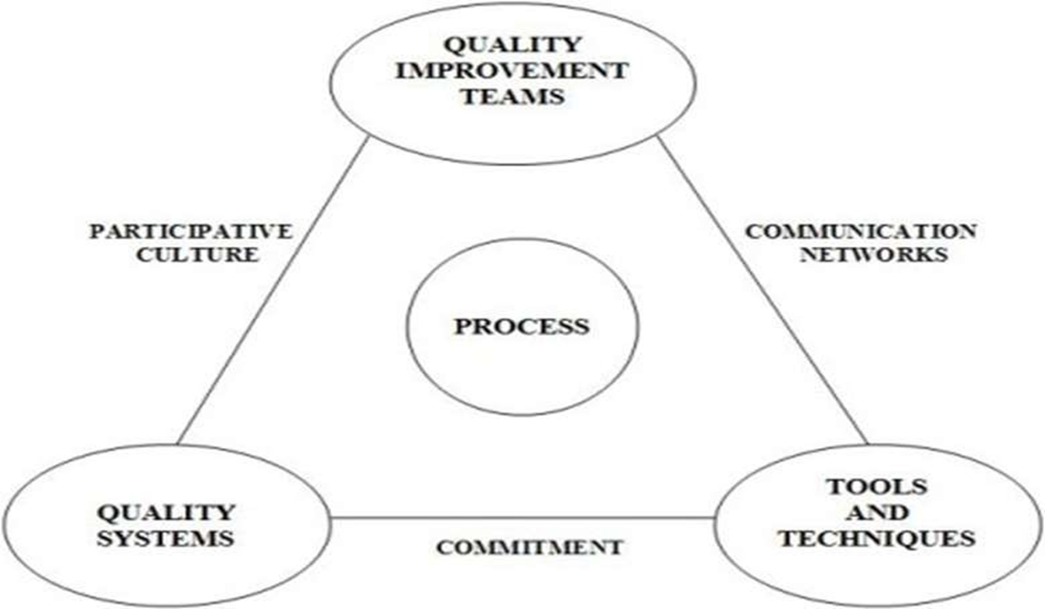
SYLLABUS OF UNIT 2
TQM Thinkers and Thoughts:
Quality Councils – Employee involvement –Team and Teamwork- Recognition and Reward- PDCA cycle, 5S-Kaizen- TQM Gurus
Models of TQM (CO2)

Slide 2
TOPIC 1: QUALITY COUNCILS
Quality Councils
Definition
A Quality Council is a group of managers and employees responsible for planning and monitoring quality improvement activities. OR..
Functions
Develop quality policies
Set quality goals
Monitor TQM implementation
Review quality performance
Benefits
Better coordination
Continuous improvement
Employee participation
Develop the strategic long-term plan with goals and the annual quality improvement program with objectives
STRUCTURE OF QC:
Quality council is composed of,
1.Chief Executive Officer
2.Senior managers of functional areas (marketing, finance, HR,
Quality)
3.Coordinator/consultant (big organizations prefer coordinator
while small organizations prefer consultant)
4.Union representative
5.Front-line representatives

Slide 3
Quality Councils (CO2)
COORDINATOR
Coordinator is necessary to perform some of the important duties. The person selected for this position should be social, active and resourceful. He will report to CEO.
Duties of coordinator
Coordinator's duties are to, build two way trust convey team needs to the council and convey expectations of council to teams brief the council on progress of teams ensure that the teams are empowered and know their duties assist the team leaders share the lessons learned among the teams
In smaller organizations where managers may be responsible for more than one functional area, the number of members will be smaller. Also, a consultant would most likely be employed rather than a coordinator.
In general, the duties of the quality council are to:
Develop, with input from all personnel, the core values, vision statement, mission statement, and quality policy statement.
Develop the strategic long-term plan with goals and the annual quality improvement program with objectives.
Create the total education and training plan.
Determine and continually monitor the cost of poor quality.

Slide 4
Topic 2:EMPLOYEE EMPOWERMENT(CO2)
Empowerment means giving people authority to make decisions based on what they feel is right, have control over their work, take risks and learn from mistakes, and promote change.
Empowerment is the process of enabling or authorizing an individual to think, behaves, take action, and control work and decision making in autonomous ways. This means leaders and managers relinquishing some of their powers that they previously held in terms of decision-making.
Empowerment diffuses decision making to employees so that employees make decisions regarding what they do and how they do it. Empowering employees is giving employees ‘ownership of their job.
Definition(Employement Involvement)
Participation of employees in decision-making and quality improvement activities.
Importance
Improves productivity
Increases job satisfaction
Encourages teamwork
Reduces errors
Methods
Suggestion schemes
Quality circles
Team meetings

Slide 5

Quality Cost and Its Categories
Quality cost is the cost incurred to maintain good product quality and avoid defects.
Prevention Cost – Cost to prevent defects before production. Example: Employee training. ‘
2.Appraisal Cost – Cost for inspection and testing of products. Example: Quality checking.
3.Internal Failure Cost – Cost of defects found before delivery. Example: Rework of defective products.
4.External Failure Cost – Cost of defects found after delivery. Example: Warranty and product replacement.

Slide 6
Topic 3:Team and Teamwork
Teamwork is a fundamental element of total quality because it is organizations not individuals that produce products and provide services which makes peak performance and continual improvements.
Team
A group of people working together to achieve a
common goal.
Teamwork
Cooperation among employees for better quality
and productivity.
Advantages
Better problem solving
Increased creativity
Improved communication
Higher efficiency
Types of Teams
Quality improvement teams
Cross-functional teams
Self-managed teams
Types of team
Functional Team – Members from the same department working under one manager.
Cross-Functional Team – Members from different departments working for a common task.
Matrix Team – Employees report to more than one manager.
Contract Team – Outsourced team working on a contract basis.
Operational Team – Team responsible for smooth daily operations

Slide 7
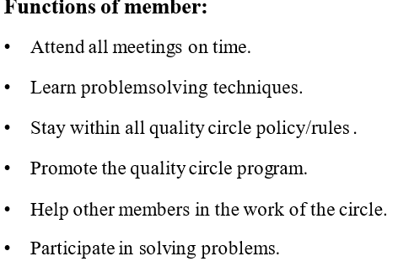
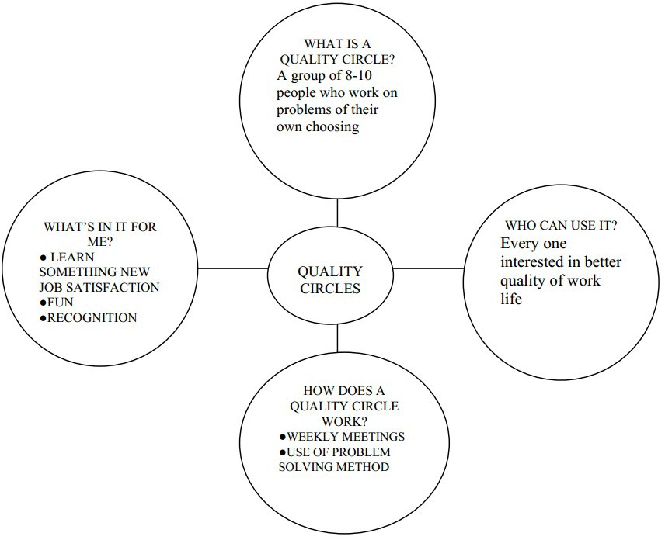
Quality circle (CO2)
Quality Circle is a small group of employees working in the same work area or doing a similar type of work who voluntarily meet regularly to identify, analyze and resolve work-related problems, leading to improvement in their total performance, and enrichment of their work life.
Features:
Quality circle is a small group of employees.
Quality circle is organized in the same work
area or doing similar type of work.
Quality circles are voluntary.
Quality circle leads to total performance.

Slide 8
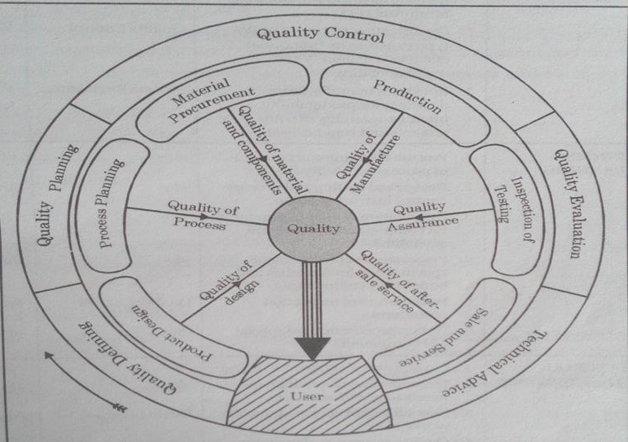
Quality circle (TQM Circle) (CO2)

Slide 9
Topic 4:Recognition and Reward (CO2)
Topic 5:5S-Kaizen
Definition
Recognizing and rewarding employees for good performance and quality
improvement.
Types of Rewards
Financial rewards
Promotions
Certificates and awards
Appreciation and recognition
Benefits
Employee motivation
Better performance
Increased commitment
Definition
A Japanese workplace management technique for cleanliness and efficiency.
Five S’s
Seiri (Sort) – Remove unnecessary items
Seiton (Set in Order) – Arrange items properly
Seiso (Shine) – Clean workplace regularly
Seiketsu (Standardize) – Maintain standards
Shitsuke (Sustain) – Follow discipline continuously
Benefits
Safe workplace
Better productivity
Reduced waste

Slide 10

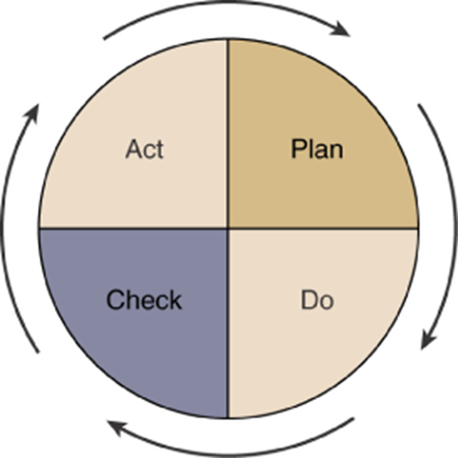
Quality circle (TQM Circle) (CO2)
TOPIC 6: TQM Gurus
Quality Gurus
Individuals who have been identified as making a significant contribution to improving the quality of goods and services.
Walter A. Shewhart
W. Edwards Deming
Joseph M. Juran
Armand Feigenbaum
Philip Crosby
Genichi Taguchi
Kaoru Ishikawa
TQM Gurus
a) W. Edwards Deming
Developed 14 points of quality management
Introduced PDCA cycle
Definition
A continuous improvement cycle developed by W. Edwards Deming.
Steps of PDCA
P – Plan
Identify problems and plan improvements.
D – Do
Implement the plan.
C – Check
Check and measure results.
A – Act
Take corrective action and standardize improvements.
b) Joseph M. Juran
Defined quality as “Fitness for use”
Developed Juran Trilogy
c) Philip Crosby
Concept of “Zero Defects”
Quality means conformance to requirements

Slide 11
Quality circle (TQM Circle) (CO2)
Three of the Quality Gurus Compared
Basis | Philip Crosby | W. Edwards Deming | Joseph M. Juran
Main Idea | Zero Defects | Continuous Improvement | Fitness for Use
Focus | Conformance to requirements | Process improvement | Customer satisfaction
Famous Concept | Zero Defects | 14 Points & PDCA Cycle | Juran Trilogy
Quality Responsibility | Everyone in organization | Management leadership | Management and planning
Goal | Defect-free products | Continuous quality improvement | Meeting customer needs

Slide 12
Quality Gurus (Cont’d)
1.W. Edwards Deming
Advocated Statistical Process Control (SPC)
Methods which signal shifts in a process that will likely lead to products and/or services not meeting customer requirements.
Emphasized an overall organizational approach to managing quality.
Demonstrated that quality products are less costly than poor quality products.
Identified 14 points critical for improving quality.
The Deming Prize
Highest award for industrial excellence in Japan.
2.Joseph M. Juran
Emphasized the importance of producing quality products through an approach focused on quality planning, control, and improvement.
Defined product quality as “fitness for use” as viewed by the customer in:
Quality of design • Quality of conformance
Availability • Safety • Field use
Categorized the cost of quality as:
Cost of prevention
Cost of detection/appraisal
Cost of failure

Slide 13
The Juran philosophy
Pursue quality on two levels:
The mission of the firm as a whole is to achieve high product quality.
The mission of each individual department is to achieve high production quality.
Quality should be talked about in a language senior management understands: money (cost of poor quality).
Quality Trilogy –
Quality planning: Process of preparing to meet quality goals. Involves understanding customer needs and developing product features.
Quality control: Process of meeting quality goals during operations. Control parameters. Measuring the deviation and taking action.
Quality improvement: Process for breaking through to unprecedented levels of performance. Identify areas of improvement and get the right people to bring about the change.
3.Armand Feigenbaum
Proposed the concept of “total quality control,” making quality everyone’s responsibility.
Stressed interdepartmental communication.
Emphasized careful measurement and report of quality costs

Slide 14
Quality Gurus (Cont’d)
4.Philip Crosby
Preached that “quality is free.”
Believed that an organization can reduce overall costs by improving the overall quality of its processes.
Basic Elements of Improvement
Determination (commitment by the top management)
Education (of the employees towards Zero Defects (ZD))
Implementation (of the organizational processes towards ZD)
5.Genichi Taguchi
Emphasized the minimization of variation.
Concerned with the cost of quality to society.
Extended Juran’s concept of external failure.
6.Kaoru Ishikawa
Developed problem-solving tools such as the cause-and-effect (fishbone) diagram.
Called the father of quality circles.

